Slide 1

CPSC 240 Computer Organization and Assembly Language
Debug
First Program
Instructor: Yitsen Ku, Ph.D.
Department of Electrical Engineering,
California State University, Fullerton, USA

Slide 2
Open Ubuntu Tuffix on VCL

Slide 3
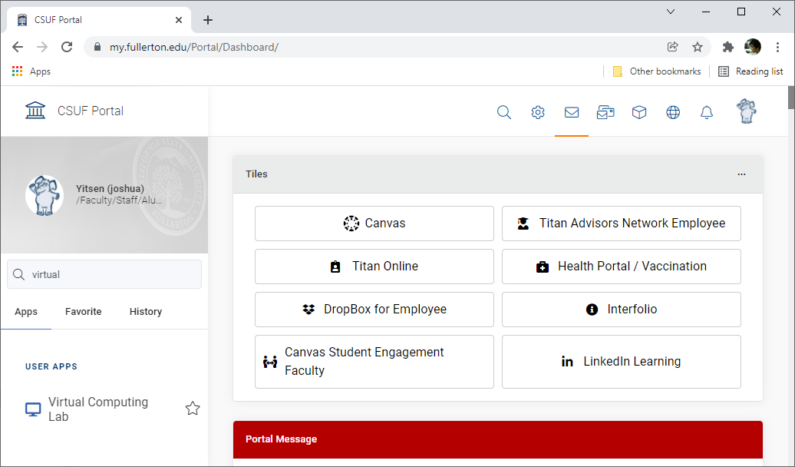
a. Search "Virtual" in Portal, and click "Virtual Computing Lab".

Slide 4
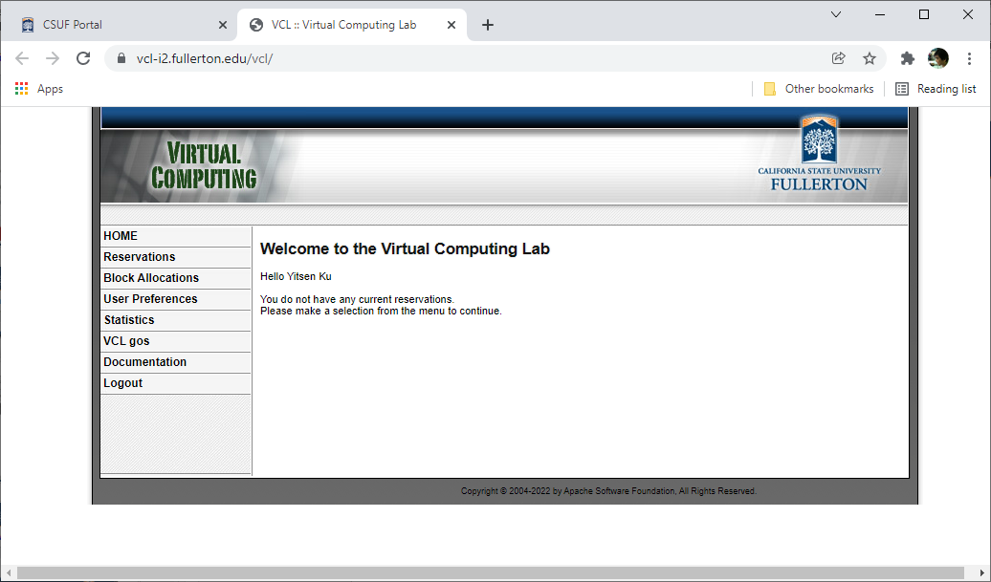
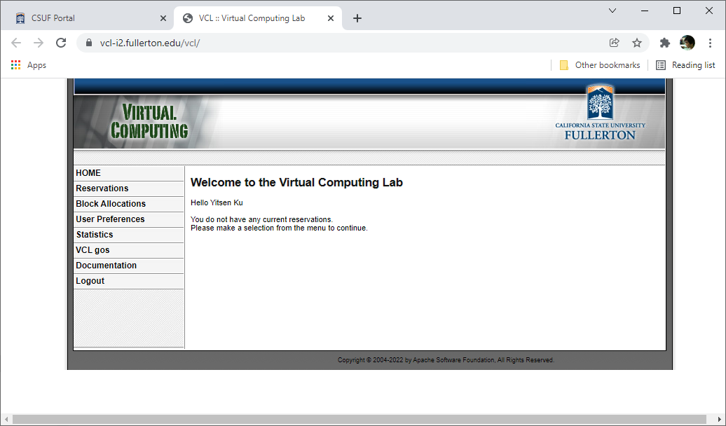
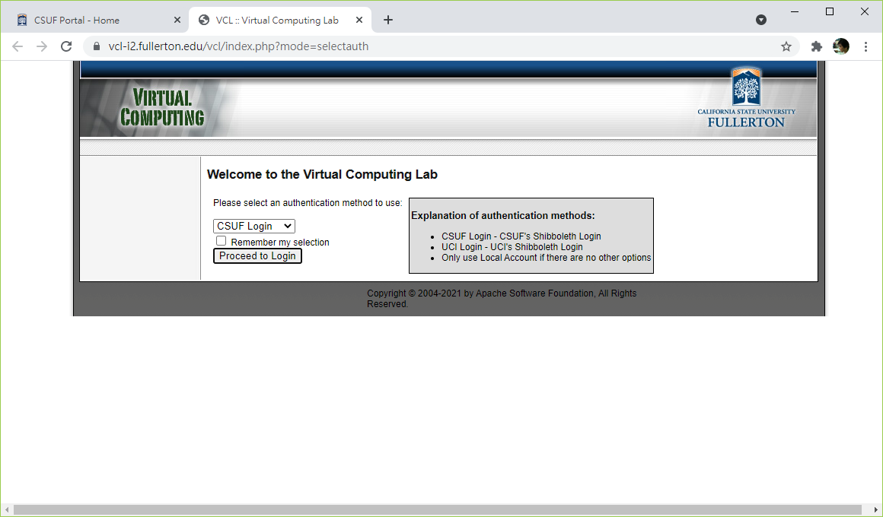
b. Click "Proceed to Login" in the Virtual Computing Lab.

Slide 5
c. Select "Reservations" in the Virtual Computing Lab.

Slide 6
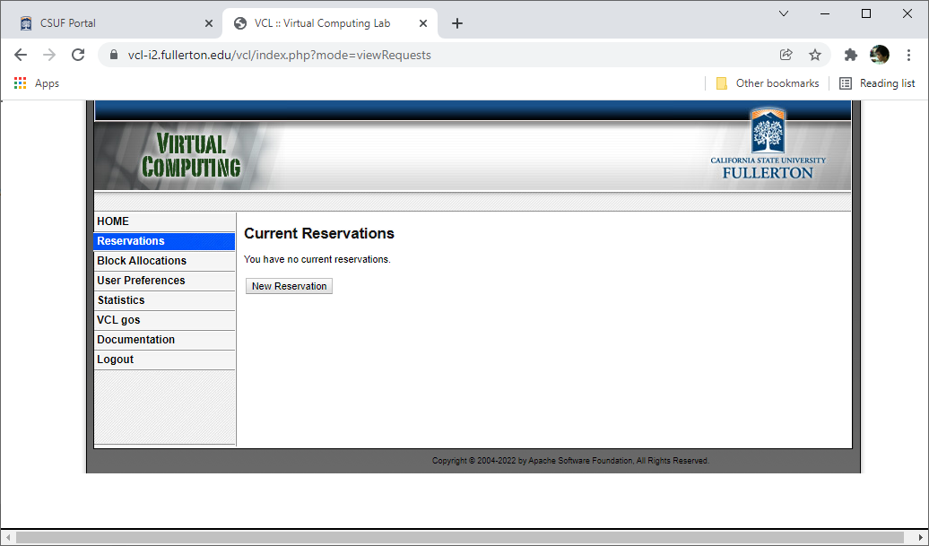
d. Click "New Reservation" button to open New Reservation dialog.

Slide 7
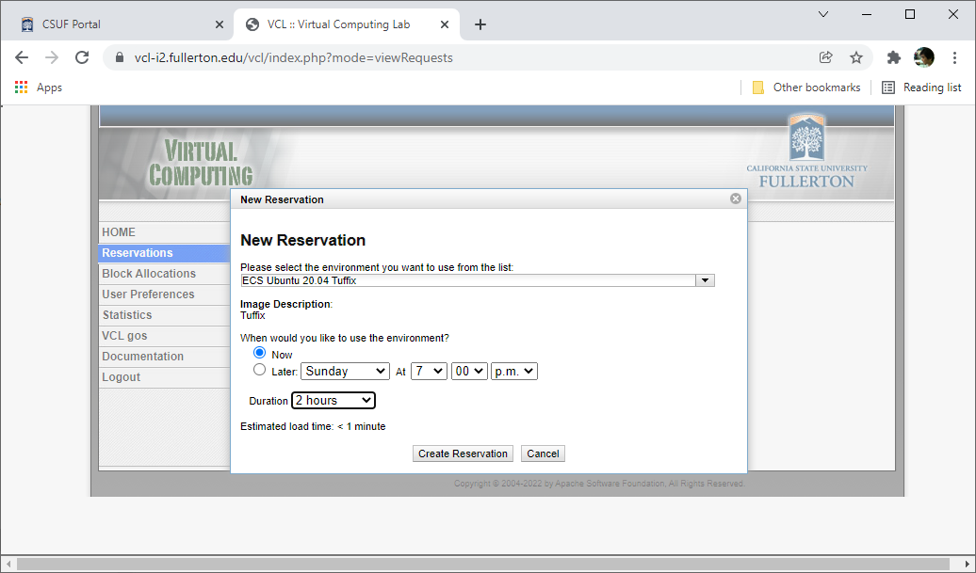
e. Select "ECS Ubuntu 20.04 Tuffix" and select "Duration=1/2/4 hours". Click "Create Reservation" button.

Slide 8
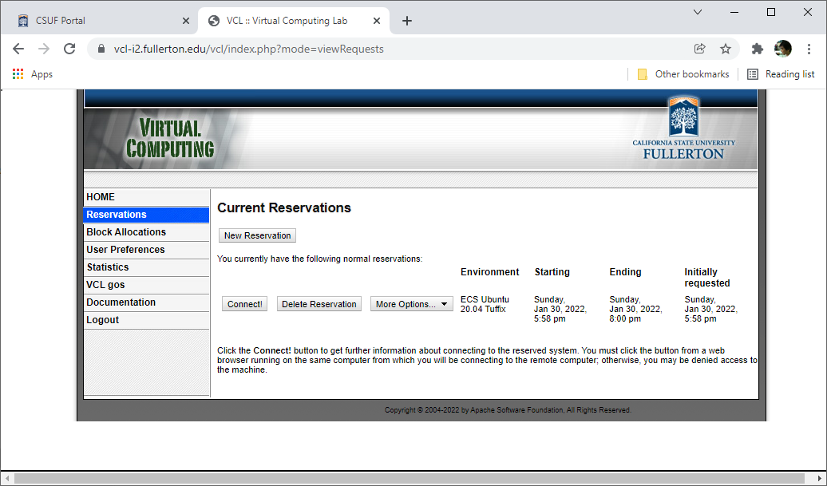
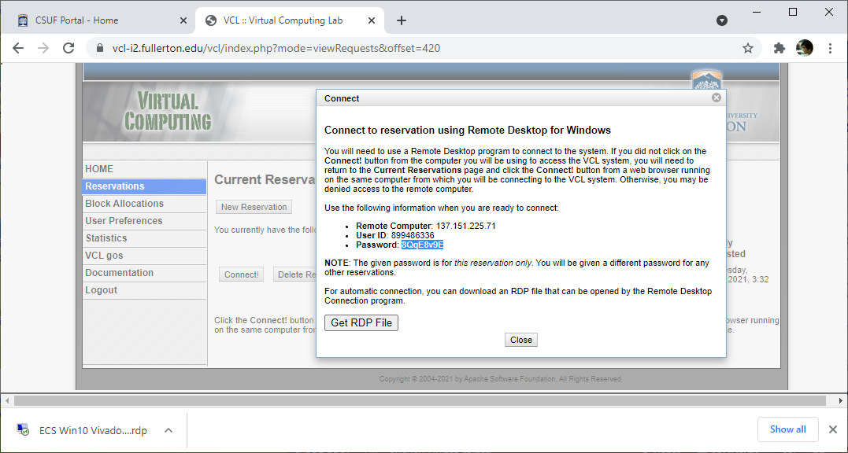
f. Click "Connect!" to open "Connect" dialog.

Slide 9
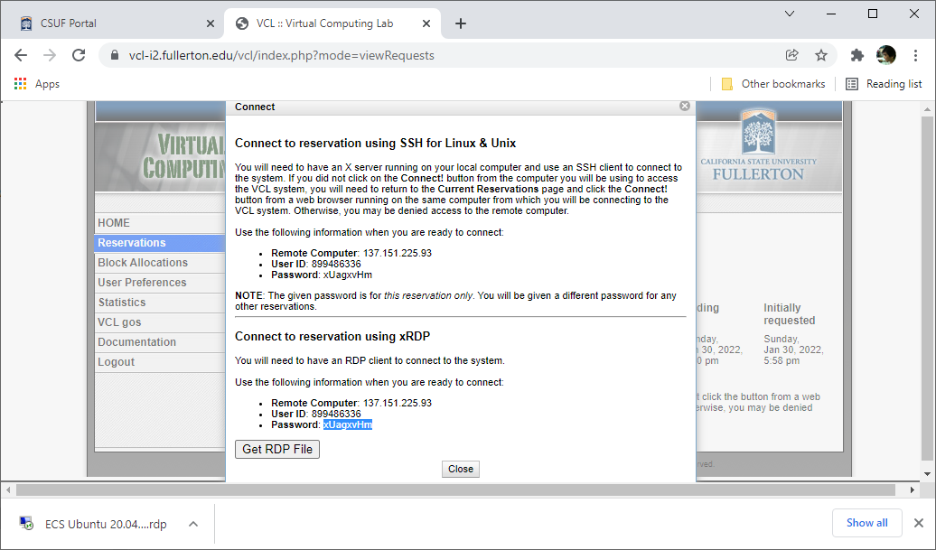
g. Click "Get RDP file" button. Click the " ECS Ubuntu 20.04 Tuffix.rdp" file to log in.

Slide 10
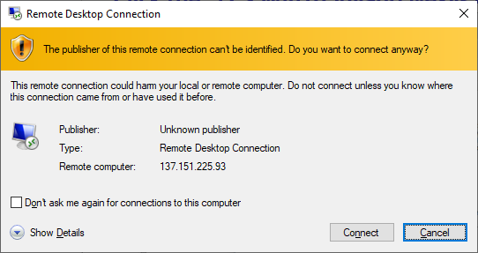
h. Click the "Connect" button to continue.

Slide 11
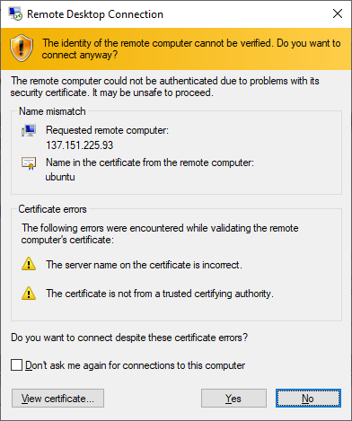
i. Click the "Yes" button to continue.

Slide 12
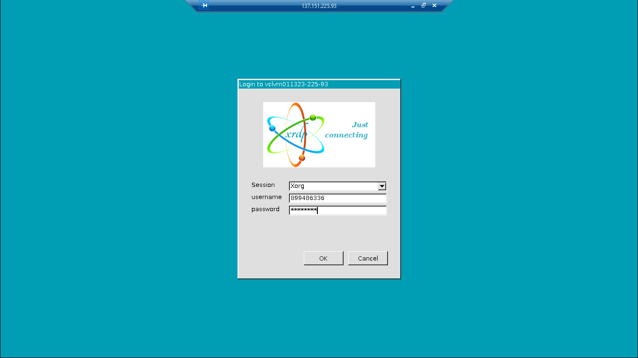
j. Input password and click the "OK" button to continue.

Slide 13
Upload Program

Slide 14
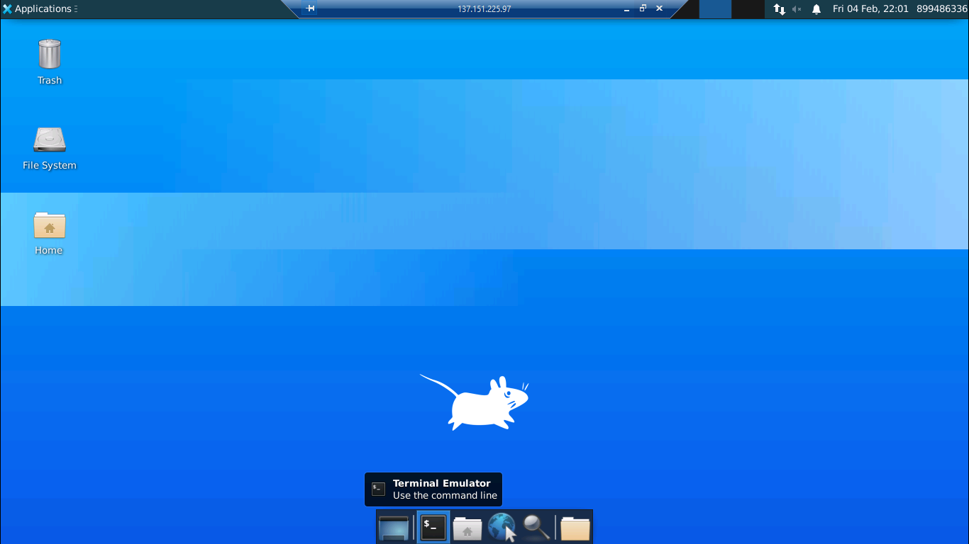
a. Click the "Terminal Emulator" to open the "Terminal Emulator" window.

Slide 15
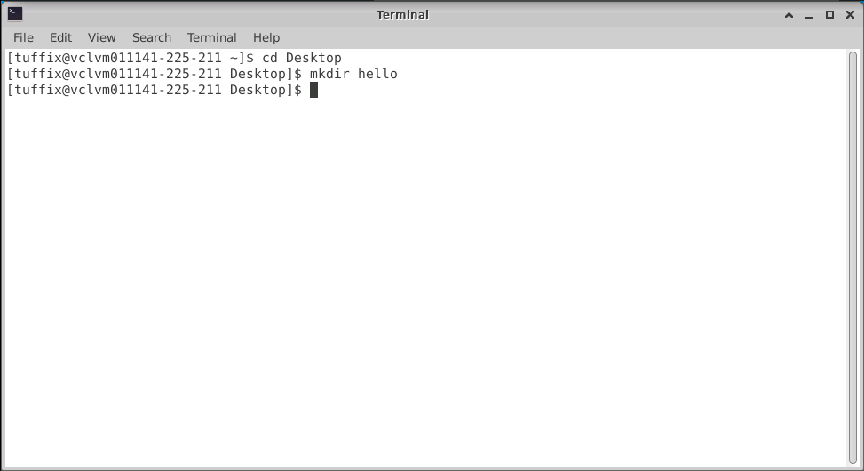
b. Input "cd Desktop" to change directory to "Desktop". Input "mkdir hello" to create a "hello" folder.

Slide 16
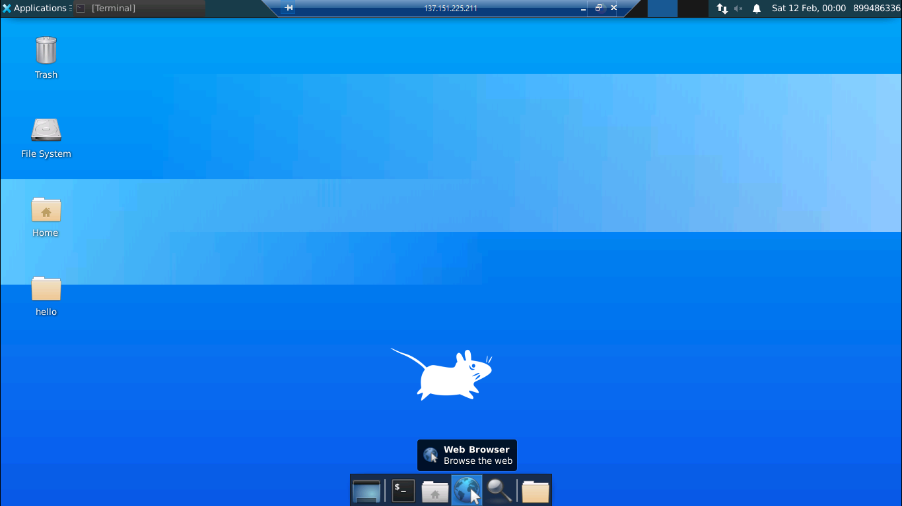
a. Switch to "Desktop" and click on "Web Browser" icon to open the "Web Browser".

Slide 17
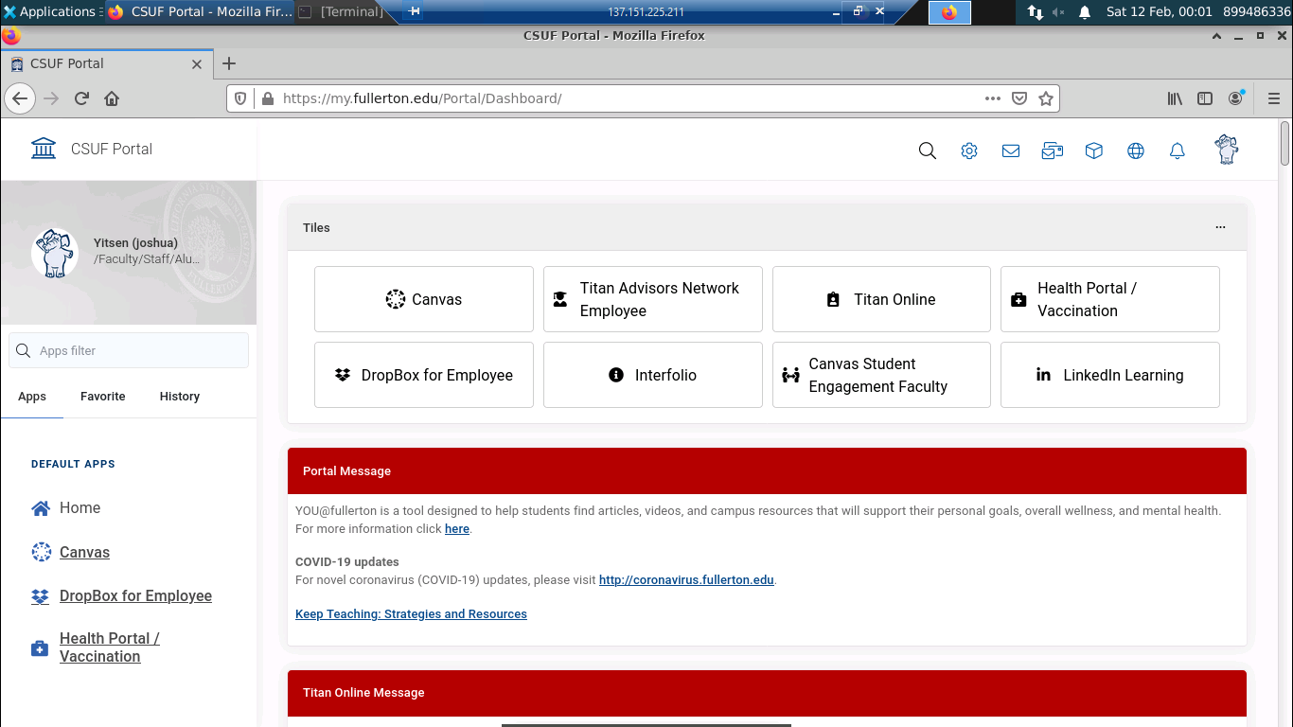
b. Open "CSUF portal" and click on the "DropBox".

Slide 18
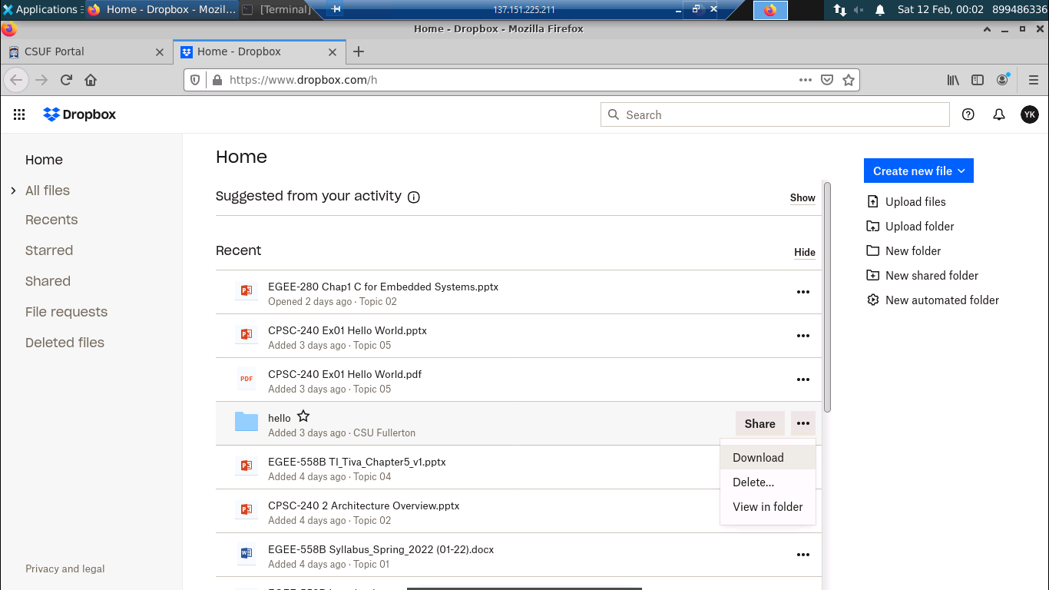
c. Click on "…" of the "hello" folder and select the "Download" item to download "hello" folder.

Slide 19
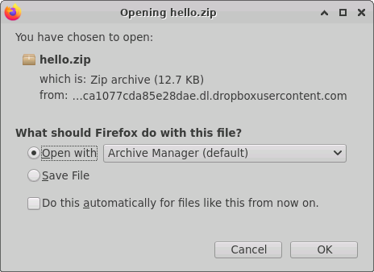
d. Click the "OK" button of the "Opening hello.zip" dialog to continue...

Slide 20
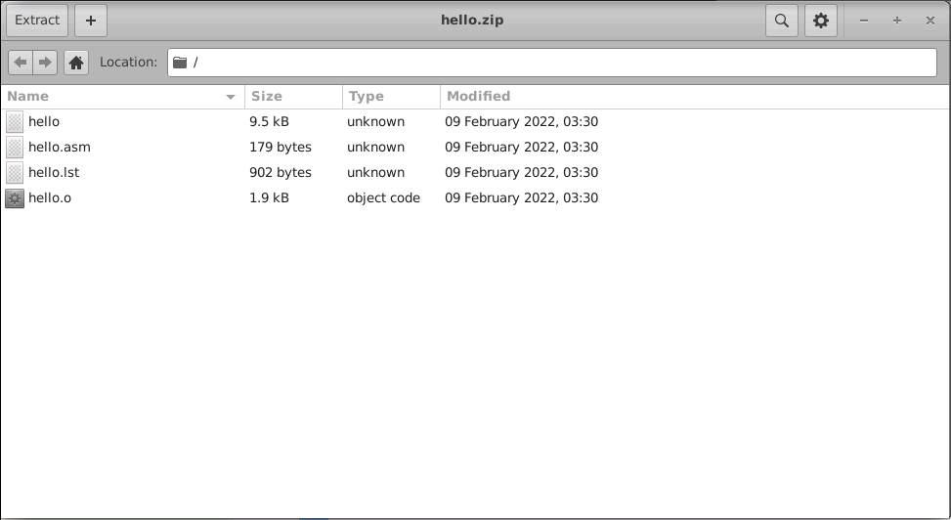
e. Click the "Extract" button to continue...

Slide 21
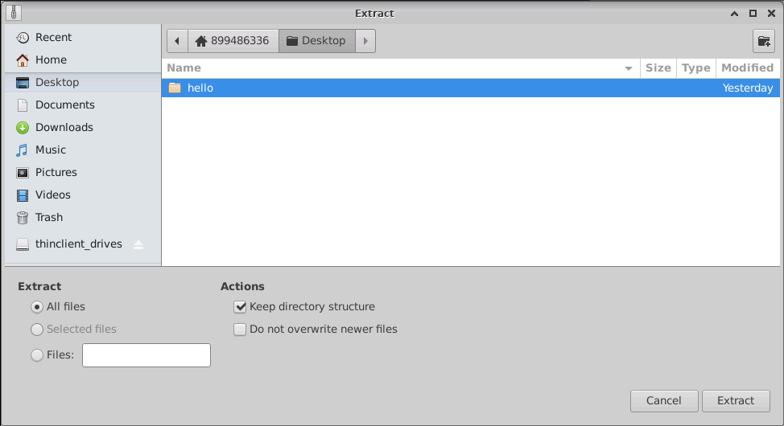
f. Select the "Desktop/hello" folder and click the "Extract" button to extract the zip file to the "hello" folder.

Slide 22
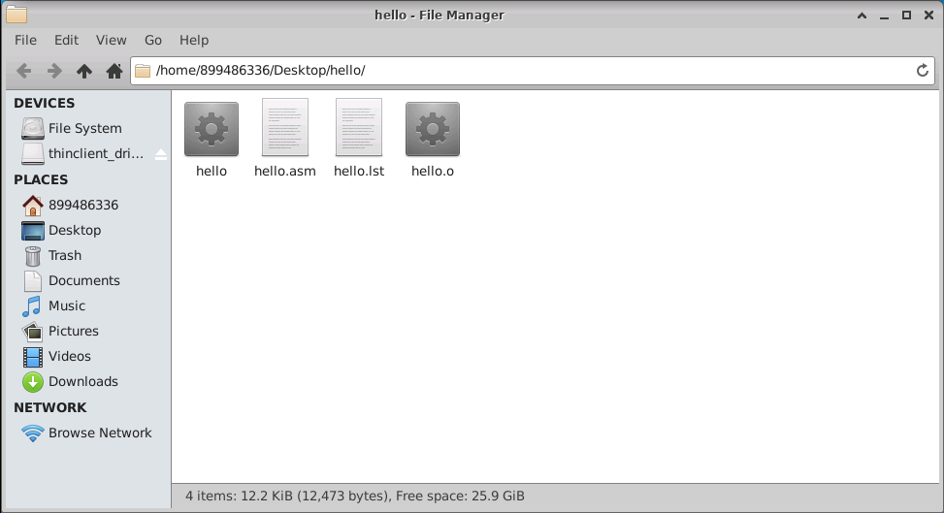
g. Switch to "Desktop" and open "hello" folder to check the files.

Slide 23
Create New Program

Slide 24
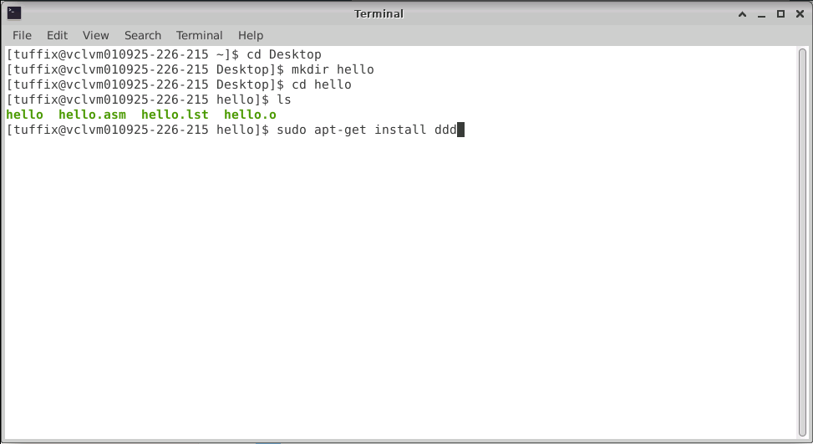
a. Switch to "Terminal" window. Input the "cd hello" to change directory to "hello". Input the "sudo apt-get install ddd" command to install "ddd" debugger.

Slide 25
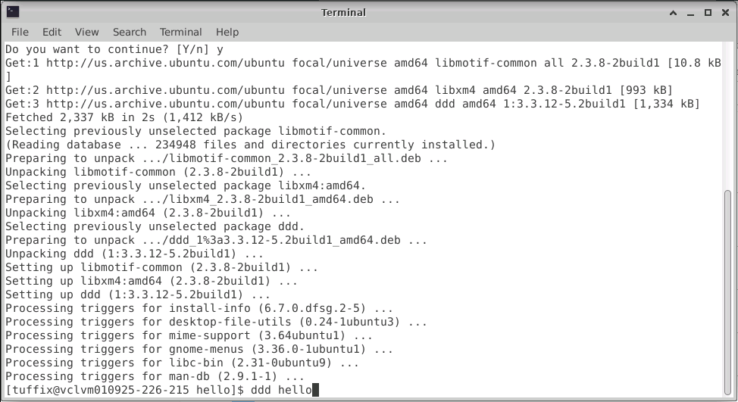
b. Input the "ddd hello" command after installing the "ddd" debugger.

Slide 26
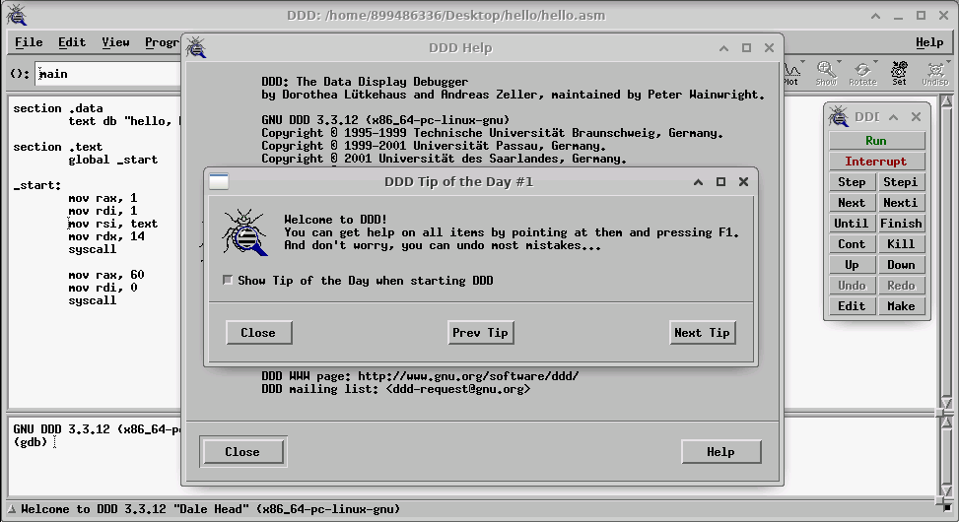
c. Click the "Close" button to close the "DDD Tip of the Day" window, and Click the "Close" button to close the "DDD Help" window.

Slide 27
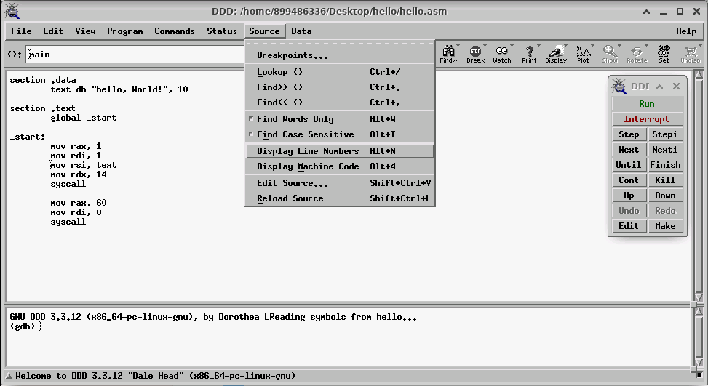
d. Select "Source/Display Line Numbers" to display line numbers to the left of the instructions.

Slide 28
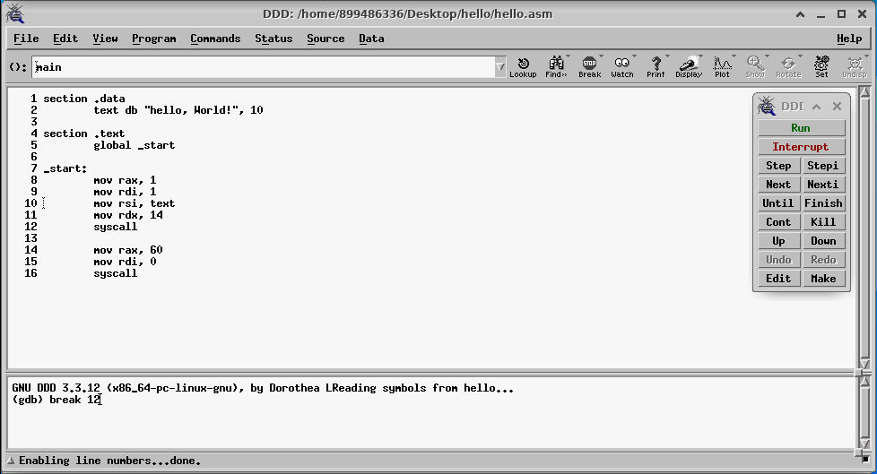
e. Input "break 12" command to set a breakpoint on line 12.

Slide 29
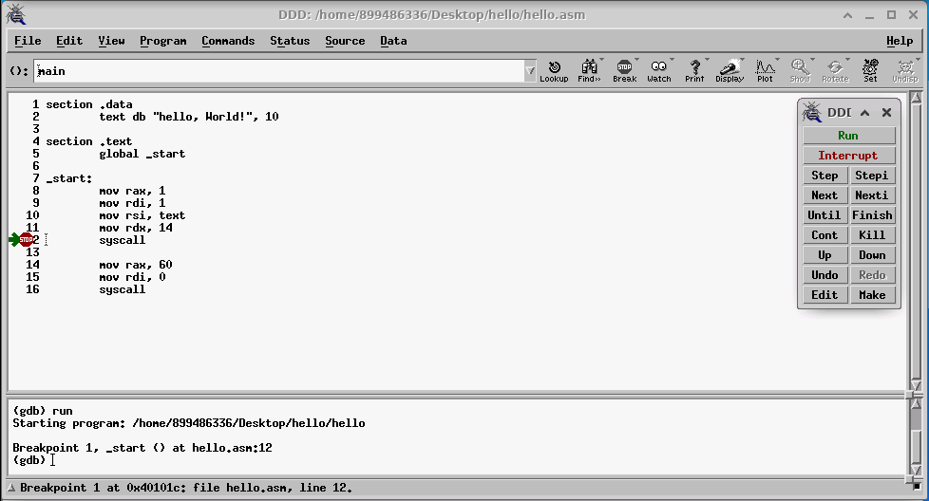
f. Click the "Run" button to simulate to line 12, as shown in the "gdb" panel.

Slide 30
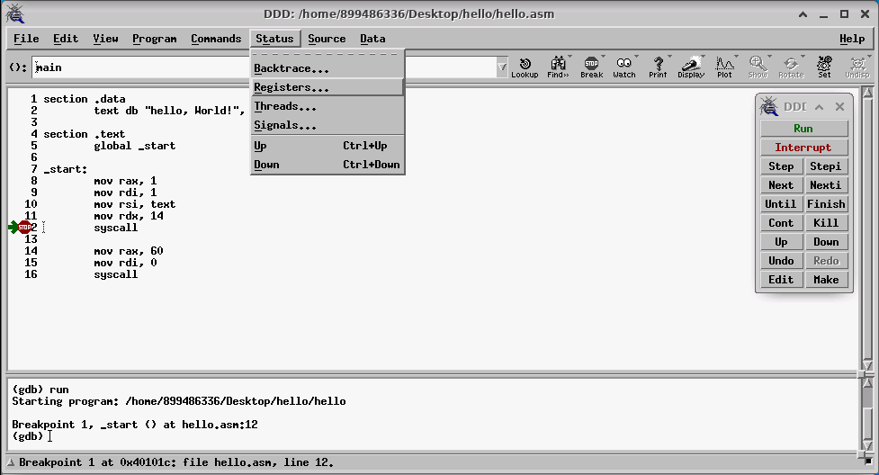
g. Select "Status/Registers…" item to open "DDD: Registers" window.

Slide 31
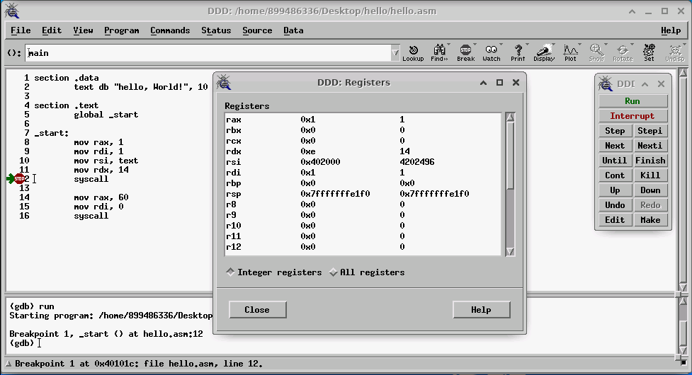
h. The "DDD: Registers" window shows rax=1, rdi=1, rsi=0x402000, and rdx=14. Agree with the instructions on lines 8 to 11.

Slide 32
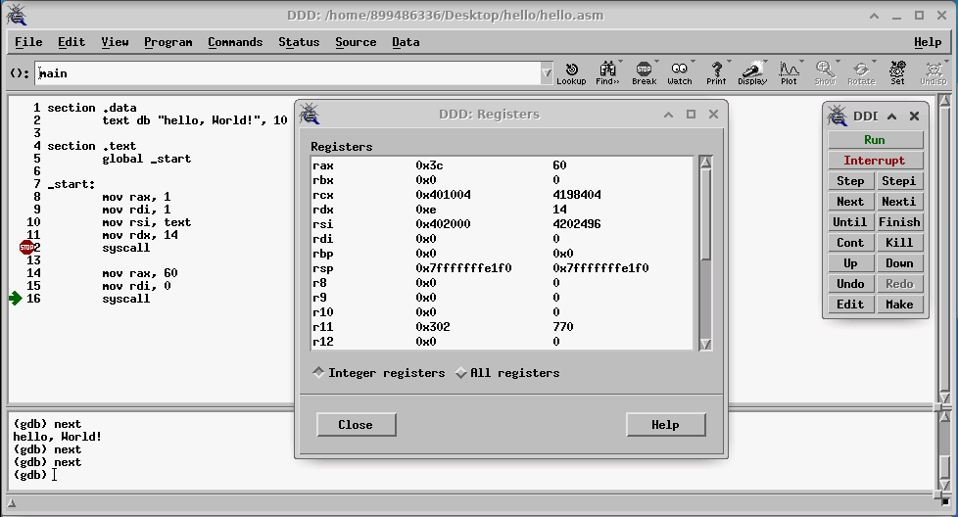
i. Click the "Next" button once and the "gdb" panel displays the "hello, World!" string. Continue to click the "Next" button twice, then rax=60 and rdi=0, as shown in the "DDD: Registers" window.

Slide 33
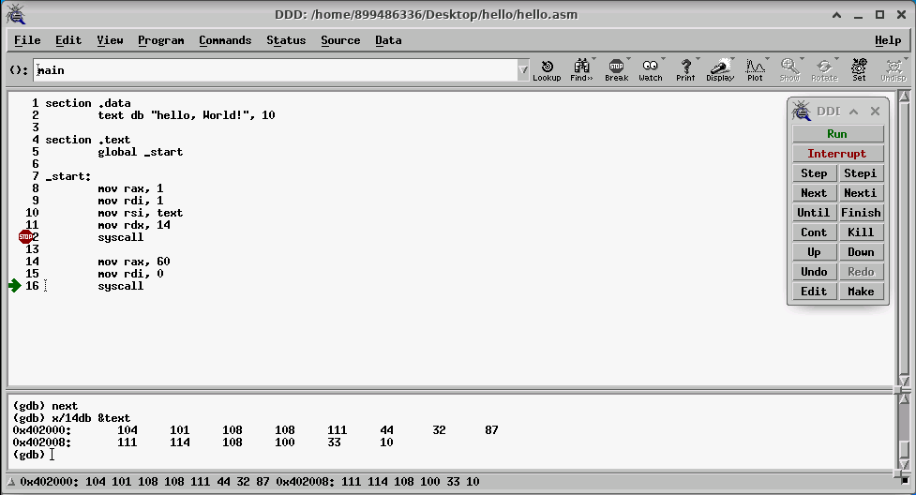
j. Input "x/14db &text" command in the "gdb" panel to display the ASCII code of the string "text".

Slide 34
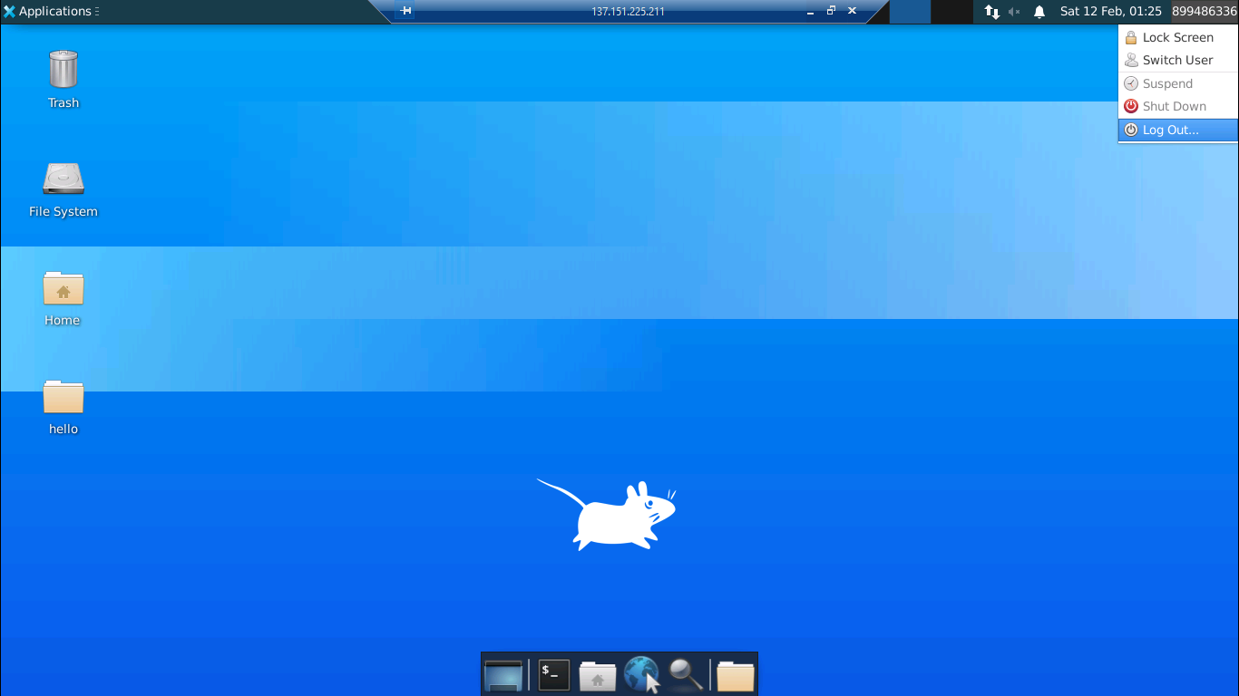
k. Close all windows and select "CWID/Log Out…" to terminate the "Remote Desktop".

Slide 35
Thanks

